Slide 1
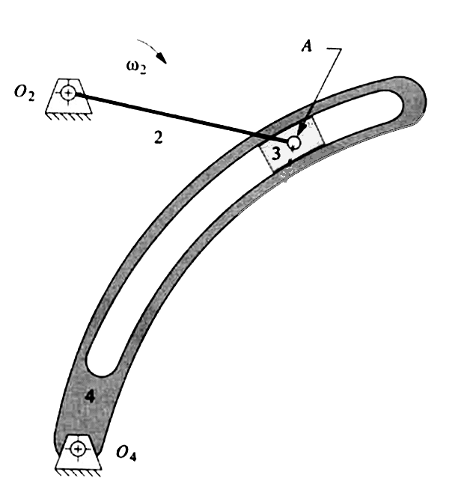
Problem 4
ω₂ = 1.000
1.0
1.631
3.56
4.41
  Find the relative acceleration of the slider block with respect to the curved slot in the mechanism shown in figure. Assume ω₂=1 unit angular velocity clockwise, α₂=0, O₂A=1 unit length. Use graphical method of acceleration analysis using vectors.

Slide 2
Velocity diagram
O_{V}
tangent
V_{A4}
= 0.835
ω₄=0.5
V_{A2}=1
A₄
V_{A4 A3}
=1.016
A₂ , A₃

Slide 3
Acceleration diagram
O_{A}
ω₄²O₄A=0.41
α₄O₄A
A₂ , A₃
A₄
2ω₄V_{A4A3}
+V²_{A4A3}/4.41/
a_{A4A3,sliding}
tangent
normal

